Slide 1
Ant Algorithm

Slide 3
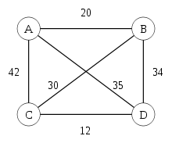
旅行推銷員問題 (Travelling salesman problem)

Slide 4
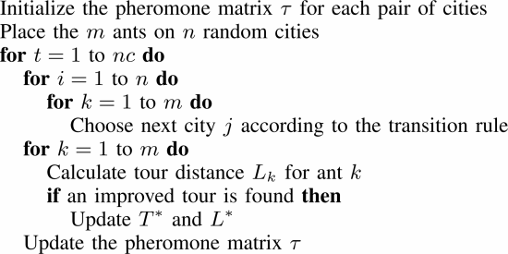
旅行推銷員問題 (Travelling salesman problem)

Slide 5
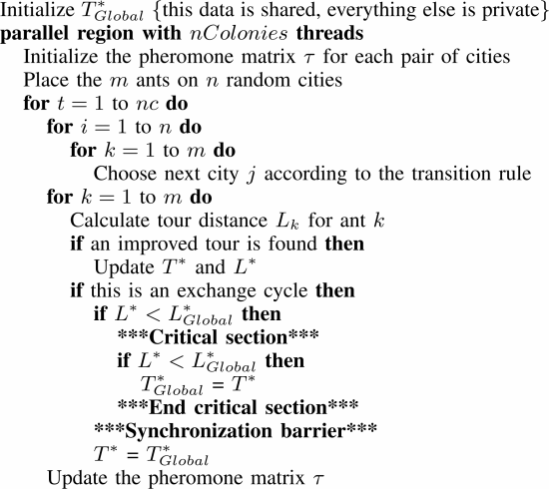

Slide 9
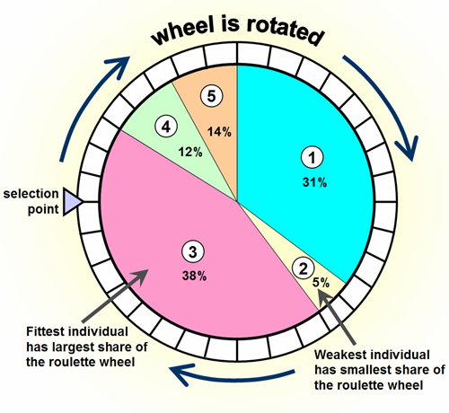

Roulette Wheel Selection

Slide 10
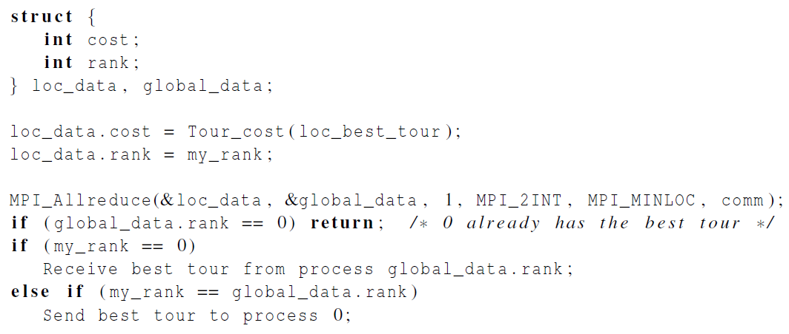

Printing the best tour

Slide 11
Homework 6
使用MPI+OpenMP實作，每一台電腦各啟動一個process，每個process再fork出multi-thread

